Slide 1
JIBEBE MECHANICAL TEAM
WEEK ONE

Slide 2
TRACTOR PERFORMANCE TESTING
The hydraulic and braking system were in a good condition.
The gearbox was also working properly.
Traction
Small wheels causing insufficient traction.
Stability
Uneven weight distribution causing a tendency to pitch or roll.
Steering
Steering play leading to over steering and under steering.

Slide 3
TRACTOR DISASSEMBLY
Unmounting the engine
Disassembling the clutch

Slide 4
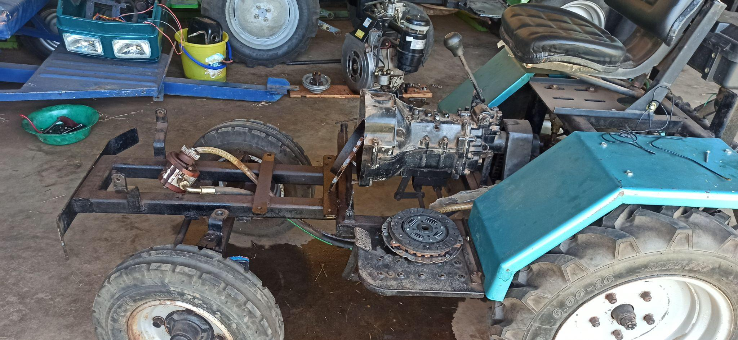

Slide 5
Design work
Material to be used is mild steel plate.
Motor and hydraulic pump mounts 3D CAD designs have been done.
Simulation is in progress.

Slide 6
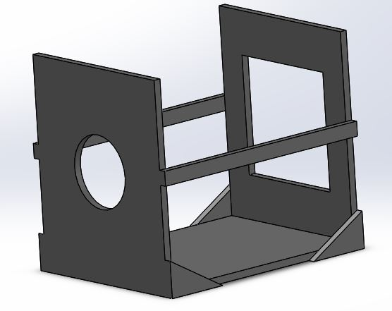
MOTOR MOUNT 3D CAD DESIGN

Slide 7
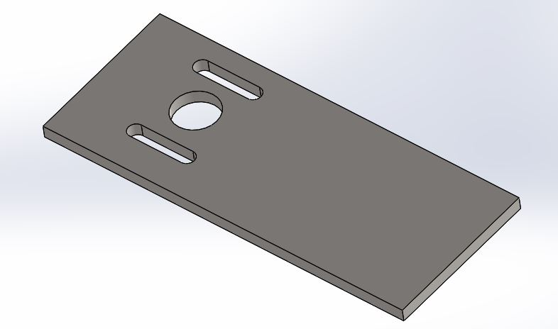
HYDRAULIC PUMP MOUNT 3D CAD DESIGN

